Slide 1


The Handmonizer
Project Course
L28
Davide Lionetti,
Antonios Pappas
Notes:
Hello everybody we are going to present our project called the Handmonizer, a sophisticated harmonizer controlled in real-time by the hand of the singer detected from a webcam through a neural network. By only moving the hand the user could choose which kind and how many harmonies to add to the lead voice with a smooth cross-fading between each setting.

Slide 2

What is the «Handmonizer»?
Digital Music Instrument (DMI)
Artist-oriented vocal improvisation tool
Tailored to the needs of jazz singer Maria Pia De Vito
Goal: enhance the singer’s live One-Woman-Band performance

Slide 3
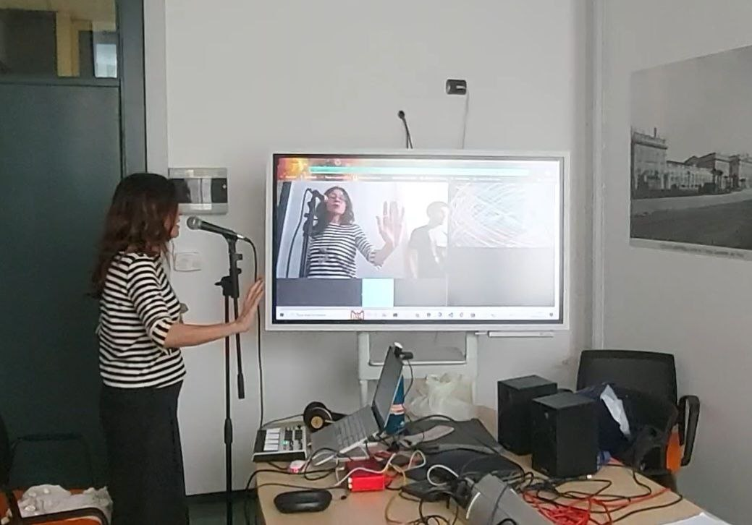
Artistic needs
Previous setup:
Eventide guitar harmonizer
Echoplex looping machine
Issues:
Unnatural/mechanical interaction
Too many physical switches/knobs
Clicking noises
Notes:
This tool is been developed to fulfil the desires of a specific artist, the jazz singer Maria pia de Vito. She was looking for an easy-to-interact instrument that could ease her actual setup.

Slide 4







Signal flow
Inputs
Processing
Output

Slide 5

Hand motion recognition
ML5.js interface, Handpose model
Returns the coordinates of 21 points
Features:
Palm center coordinates
Palm length (white line)
Palm slope (slope of the white line)

Slide 6
Supercollider algorithm

Slide 7

Structure
Pitch tracker: Tartini
Pitch shifter: PitchShiftPA (PSOLA)
Effects: Rerverb / Delay
Hand motion/gesture controls:
Palm length harmonies ON/OFF (dB mapping)
Palm center coordinates number of voices +
high/low harmonics
Palm slope effect dry/wet knob

Slide 8

Version one: fixed intervals
MIDI controlled patch switch
Fixed interval harmonies in each patch
Two patches with effects only (reverb/delay)

Slide 9

Version two: in-scale harmonizer
No patches
Set a scale and the “Handmonizer” will follow it
Disclaimer: two SuperCollider classes by Matthew Yee King were used

Slide 10

Results and improvement
Results:
Future improvements
Faster hand tracking
Stand-alone application

Slide 11

Evaluation
Questionnaire covering different aspects of the performance
Answers: grade from 1 to 10 and a short comment
Can be used to evaluate similar future projects

Slide 12
Demo

